Slide 1
6G4Z0024 Web Development Lecture 9: Dynamic pages with JS
Yanlong Zhang
Y.Zhang@mmu.ac.uk

Slide 2
Learning Objectives
To understand how to interact with REST APIs using JavaScript
Be familiar with alternatives to APIs

Slide 3
Last week recap
Understanding concept of RESTful APIs
Use of API tool, postman

Slide 4
Questions?

Slide 5
Making HTTP requests in JS
When would we want to make HTTP requests in a web application?
On click of a button
e.g. enter details into a login form, click submit, code sends request to the server to process the login
On page load
e.g. a user navigates to their profile, a request is made to get the profile data and recent posts to display on the page

Slide 6
Handling HTTP in code: button clicks
First of all, what can we do already?
Create the form in HTML
Listen for a click and get the form values validated into JS
What’s left to do?
Send the HTTP request
Handle the HTTP response

Slide 7
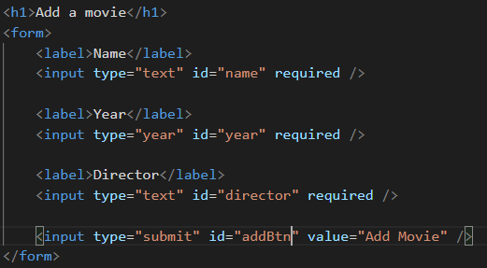
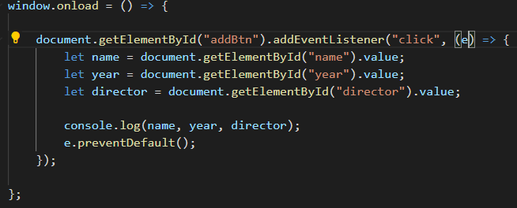
Handling HTTP in code: button clicks

Slide 8
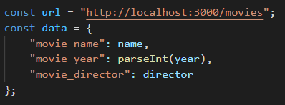
Handling HTTP in code: button clicks
First, let's create the data object ready to send
Format should be the same as in Postman

Slide 9
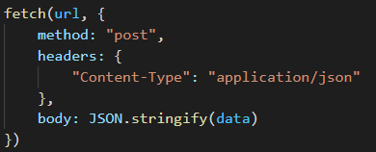
Handling HTTP in code: button clicks
Send the request using the Fetch API (built into JS)
Take in two parameters: the URL, and an object with all of the HTTP request information
Stringify the body so that it can be submitted

Slide 10
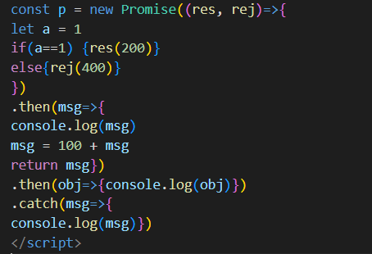
JS Promise

Slide 11
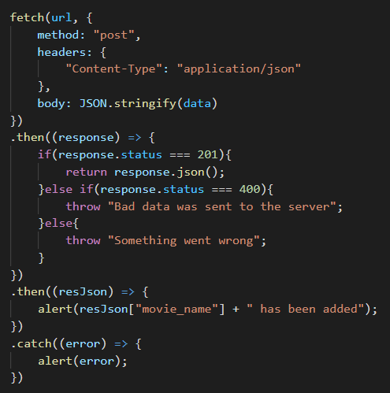
Handling HTTP in code: button clicks
The Fetch function returns a JS Promise
Multiple .then() functions can be chained together
We check the status code to see if the request was successful
A .catch() can be added to the end for handling errors
Very important slide for your assignment!

Slide 12
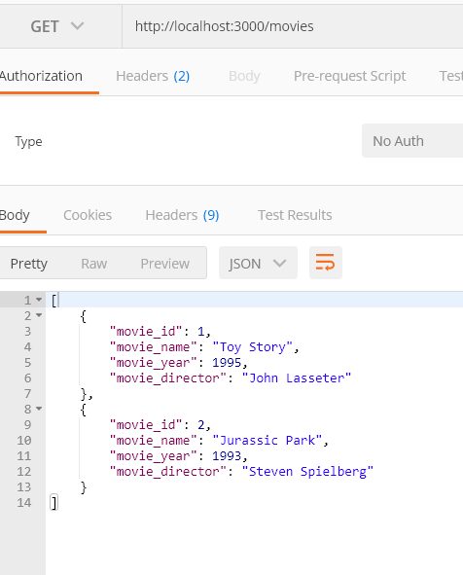
Handling HTTP in code: button clicks
Test its worked by entering a movie into the HTML form
Try some bad data and see how its handled
Try some good data and test that it has been added with Postman

Slide 13

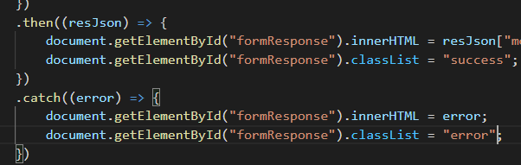
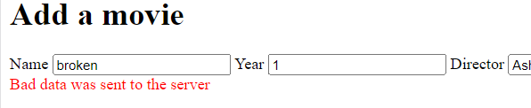
Handling HTTP in code: button clicks
Instead of ugly alert boxes, why don’t we update a div like with the validation last week…

Slide 14
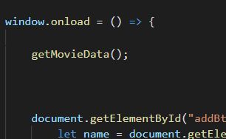
Handling HTTP in code: page loads
We are already using the window.onload function
Let’s call a function in it to load the data

Slide 15
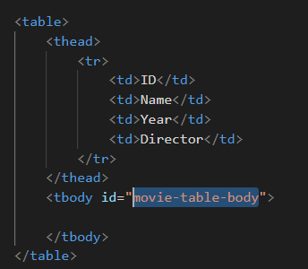
Handling HTTP in code: page loads
Before we write the function, we need somewhere for the movies to be displayed
We can create a HTML table which currently has no body
We give the body an ID so that we can use it in the JS

Slide 16
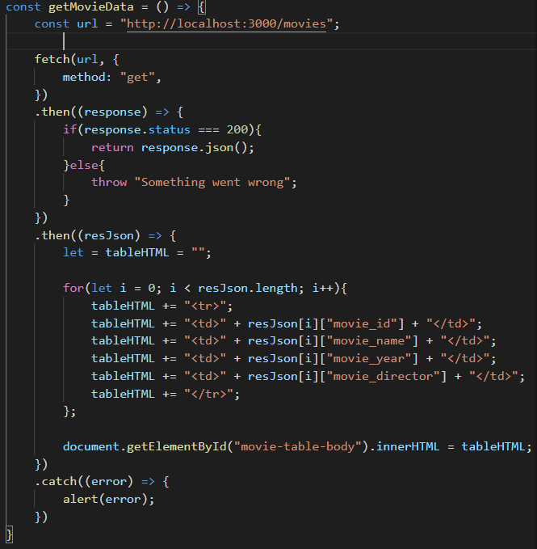
Handling HTTP in code: page loads
We use the fetch function like before
This time, it’s a GET request and we send no body
We loop through the responses to build up a string.
The string is inputted into the table to be displayed

Slide 17
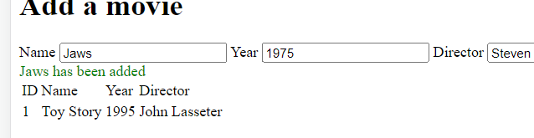
Handling HTTP in code: page loads
Test by reloading your page
One issue, when we add a movie, the table doesn’t automatically update…
How can we fix this?

Slide 18
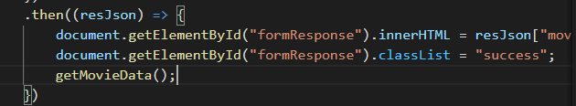
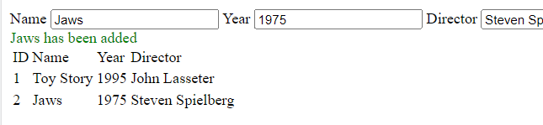
Handling HTTP in code: page loads
Simple!
Just call the getMovieData function again when a movie is successfully added
Now we can create dynamic pages that automatically update!

Slide 19
Demo: Interact with the assignment API in Postman
POST https://mudfoot.doc.stu.mmu.ac.uk/node/api/creditcard
JSON object containing “master_card”, “exp_year”, “exp_month”, and “cvv_code”
An example: { “master_card”: 5222123412341234, “exp_year”: 2025, “exp_month”: 11, “cvv_code”: “089” }

Slide 20
Alternatives to REST APIs
Out of scope for the Unit, but good to be aware of:
SOAP – Simple Object Access Protocol
Language, platform and transport independent (REST uses HTTP)
REST is easier to use and more flexible
GraphQL
One endpoint only (POST /graphql) (REST is multiple endpoints)
JSON, stateless, independent of server/front end – all like REST
Standard body (like querying a DB)

Slide 21
This week's lab
Use JS to send and receive data using HTTP
Make progress on your assignment

Slide 22
Questions?

